Slide 1
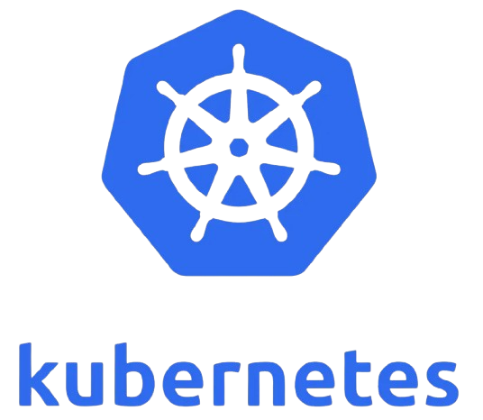
Kubernetes essentials
Robert danciu & robert balint Oct 19th

Slide 2
Agenda
Introduction
Background and origins
Why is it still relevant?
Comparison with alternatives
Core concepts & architecture
Kubernetes in action
Getting started
When (and when not) to use it
Resources & next steps

Slide 3
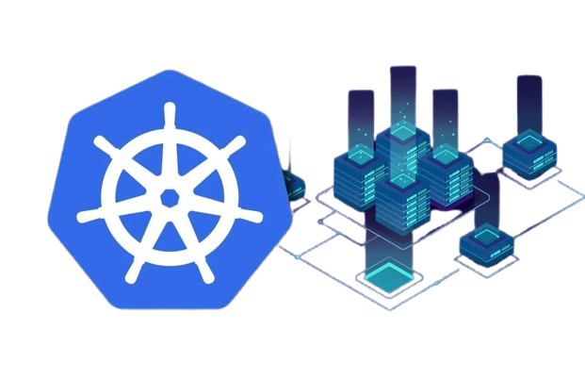
Why Kubernetes?
Containers offer portability, isolation, and efficiency
Growing container adoption requires orchestration
Kubernetes automates deployment, scaling, and management
Declarative model ensures desired state is maintained

Slide 4
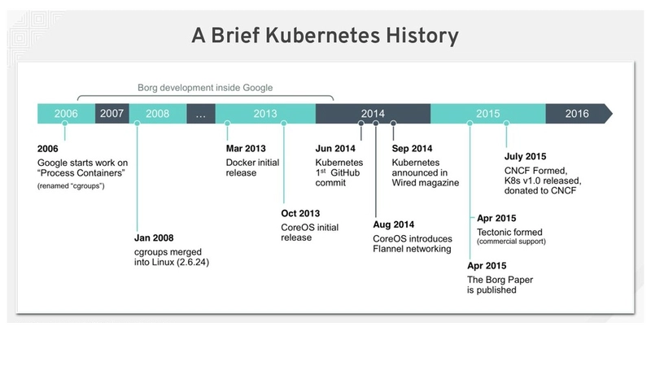
Origins of kubernetes
Developed at Google (2013), inspired by Borg and Omega
Open-sourced and donated to CNCF in 2015
Designed for on-premises, hybrid and cloud environments
Figure 1: Kubernetes history

Slide 5
Challenges Kubernetes solves
Problem | Kubernetes Solution
Managing hundreds of containers manually | Automated scheduling and placement of containers
Application failures | Self-healing, auto-restarts and rescheduling
Inconsistent deployments | Declarative configuration and versioned deployments
Risky updates | Rolling updates and instant rollbacks
Scaling issues under load | Horizontal, vertical, and cluster autoscaling
Service connectivity issues | Stable networking, DNS, and load balancing
Cloud portability challenges | Vendor-neutral API for hybrid / multi-cloud
Table 1: Kubernetes problem-solution

Slide 6
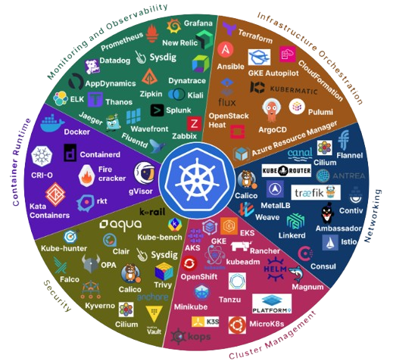
Why is it still relevant?
Dominant container orchestration platform
Large ecosystem and community support
Open-source, flexible, ad extensible
Hybrid and multi-cloud portability
Continually evolving with new features (Knative, Kubeflow)
Figure 2: Kubernetes ecosystem

Slide 7
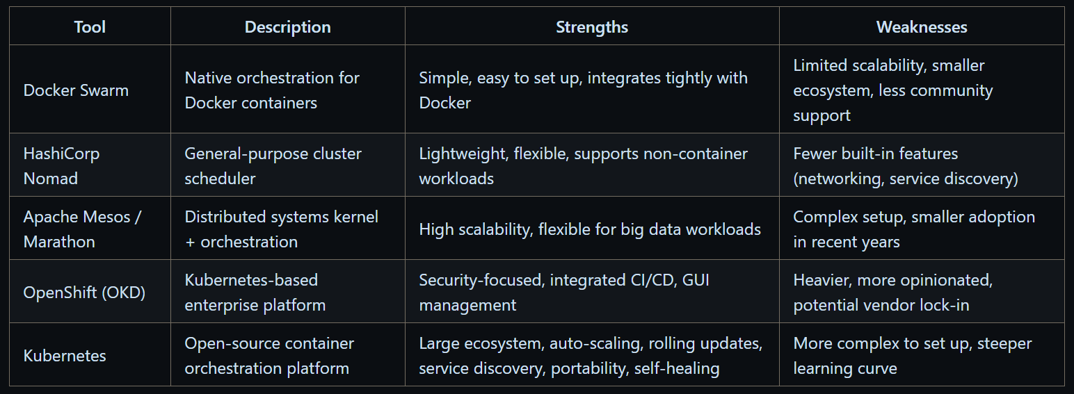
Alternative tools
Table 2: Comparison with other tools

Slide 8
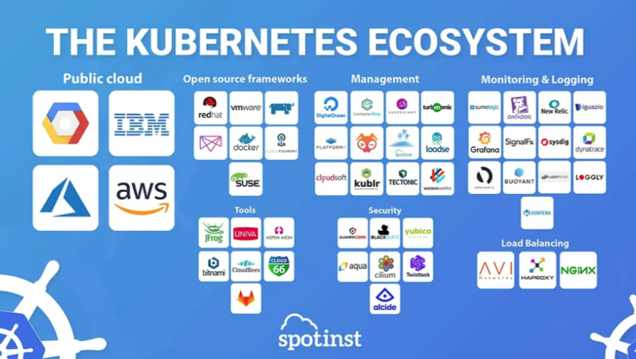
Why Kubernetes stands out?
Largest community and ecosystem
High scalability for thousands of nodes
Built-in features: auto-scaling, rolling updates, service discovery
Portability across on-prem, public, hybrid clouds
Figure 3: Kubernetes ecosystem

Slide 9
Choosing kubernetes
Powerful but not always necessary
Its adoption depends on application complexity, scaling needs, team expertise and infrastructure resources
When to use | When not to use
Microservice architecture with multiple, loosely coupled services | Monolithic applications with simple deployment requirements
Applications requiring high availability and dynamic scaling | Low-traffic or single-instance applications
CI/CD pipelines with frequent deployments | Teams with limited DevOps expertise or operational resources
Multi-cloud or hybrid-cloud deployments requiring portability | Projects with constrained infrastructure or strict simplicity requirements
Workloads that benefit from self-healing, automated scaling and rolling updated | Serverless or PaaS environments where orchestration is handled by the platform
Table 3: When (and when not) to use Kubernetes

Slide 10
How Kubernetes work?
Control plane:
API Server: manages communication
Etcd: manages the configuration data, state data and metadata
Scheduler: assigns new Pods to Nodes
Controller Manager: runs multiple control loops that watch the cluster’s state
Worker nodes:
kubelet: makes sure containers are running and healthy
container runtime: manages the execution and lifecycle of containers
kube-proxy: ensures incoming traffic is distributed evenly among the pods
Desired state model:
Continuously reconciles actual vs desired state

Slide 11
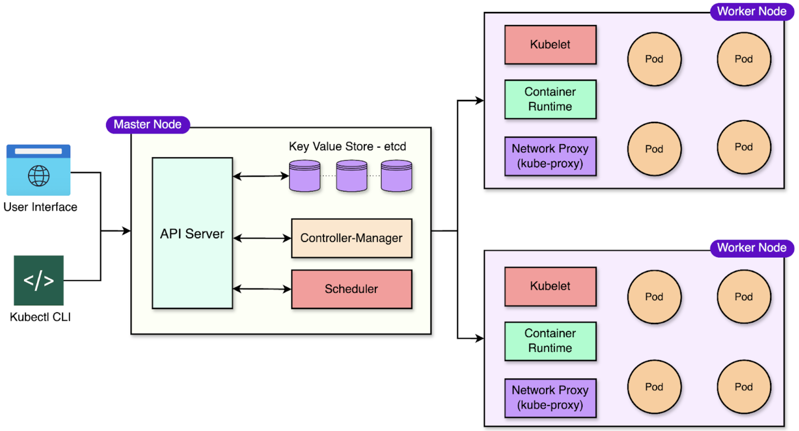
Kubernetes architecture
Figure 4: Kubernetes architecture

Slide 12
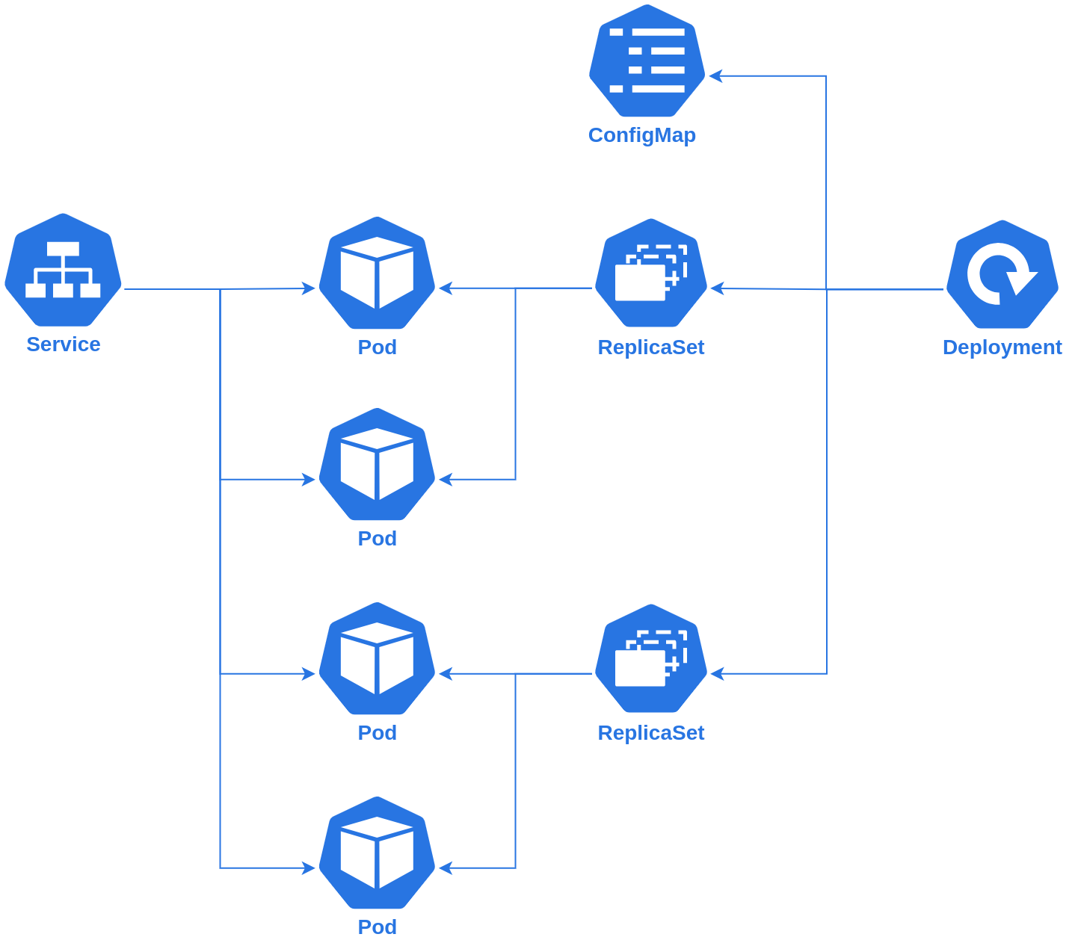
Core kubernetes concepts
Pods: Smallest deployable unit
Deployments: Manage replicas and updates
ReplicaSets: Maintain desired pod count
Services & Ingress: Networking & access
ConfigMaps & Secrets: Configuration and sensitive data
PersistentVolumes & Claims: Persistent storage
Figure 5: Kubernetes flowchart

Slide 13
Maintaining desired state
Reconciliation loop:
User defines YAML manifest
API Server stores state in etcd
Controllers detect differences
Scheduler assigns pods, kubelet monitors
Loop repeats until desired state matches
TO ADD DIAGRAM!!!!!!!!!!!!!!!!!

Slide 14
THANK YOU

